Slide 1

OOSA&D(2018)
01 Welcome to Design Patterns: an introduction

Slide 2
Glossary
pattern ['pæt(ə)n] a model considered worthy of imitation
Dalian Neusoft University of Information © Copyright

Slide 3
Agenda
A Case Analysis
Design Pattern: The Strategy Pattern
An Application for example
An experiment in class
Practices of design pattern as homework
Dalian Neusoft University of Information © Copyright

Slide 4
Agenda
A Case Analysis
Design Pattern: The Strategy Pattern
An Application for example
An experiment in class
Practices of design pattern as homework
Dalian Neusoft University of Information © Copyright

Slide 5
1. A Case Analysis
The game can show a large variety of duck species swimming and making quacking sounds.
Dalian Neusoft University of Information © Copyright

Slide 6
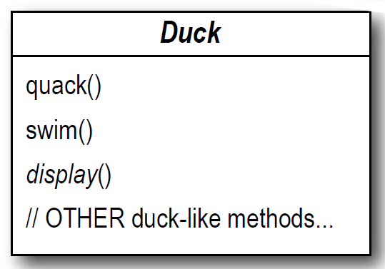
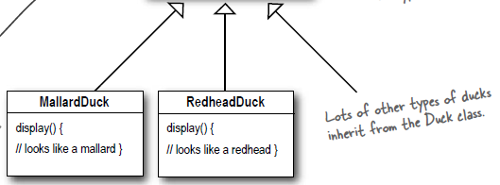
1. A Case Analysis
The game can show a large variety of duck species swimming and making quacking sounds.
Dalian Neusoft University of Information © Copyright

Slide 7
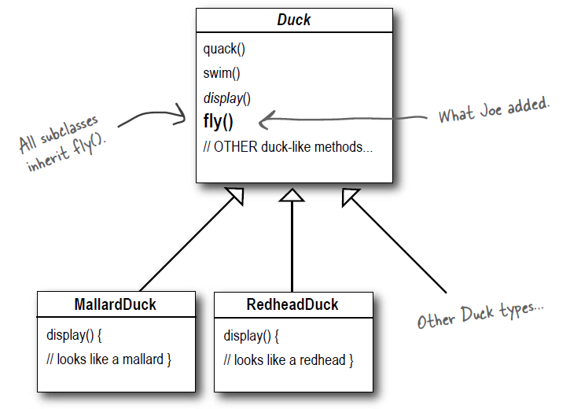
1. A Case Analysis
But now we need the ducks to FLY.
Dalian Neusoft University of Information © Copyright

Slide 8
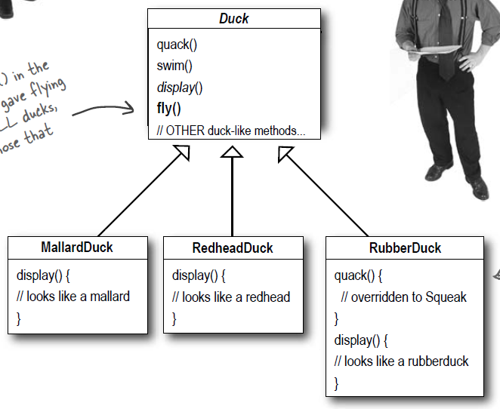
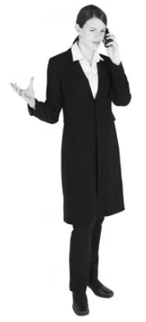
1. A Case Analysis
But something went horribly wrong...
There were rubber duckies flying around the screen.
Dalian Neusoft University of Information © Copyright

Slide 9
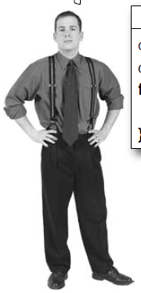
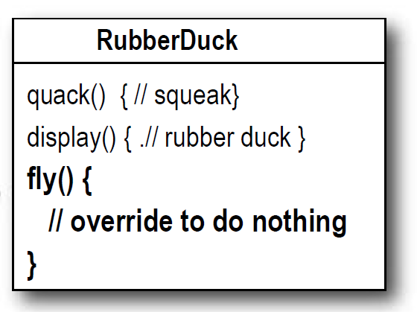
1. A Case Analysis
I could always just override the fly() method.
Dalian Neusoft University of Information © Copyright

Slide 10
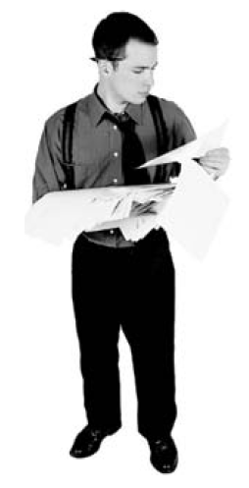
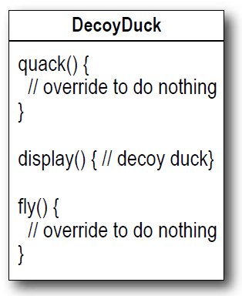
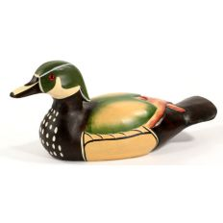
1. A Case Analysis
But then what happens when we add wooden decoy ducks to the program? They aren’t supposed to fl y or quack...
Dalian Neusoft University of Information © Copyright

Slide 11
1. A Case Analysis
Which of the following are disadvantages of using inheritance to provide Duck behavior? (Choose all that apply.)
❏ A. Code is duplicated across subclasses.
❏ B. Runtime behavior changes are difficult.
❏ C. We can’t make ducks dance.
❏ D. Hard to gain knowledge of all duck behaviors.
❏ E. Ducks can’t fl y and quack at the same time.
❏ F. Changes can unintentionally affect other ducks.
Dalian Neusoft University of Information © Copyright

Slide 12
1. A Case Analysis
Joe knows the spec will keep changing and he’ll be forced to look at and possibly override fly() and quack() for every new Duck subclass that’s ever added to the program... forever.
……
Dalian Neusoft University of Information © Copyright

Slide 13
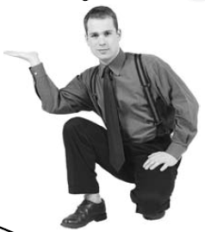
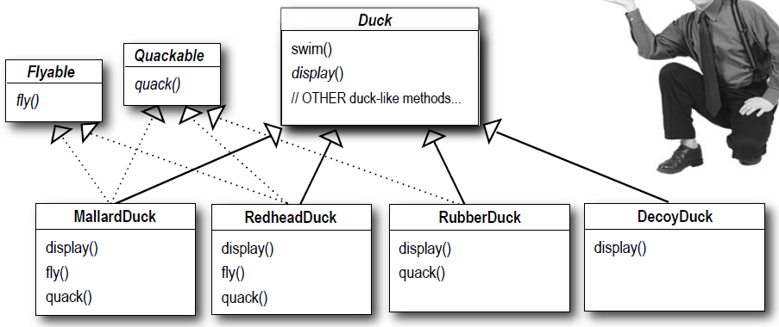
1. A Case Analysis
How about an interface?
Dalian Neusoft University of Information © Copyright

Slide 14
1. A Case Analysis
That is, like, the dumbest ! If you thought having to override a few methods was bad, how are you gonna feel when you need to make a little change to the flying behavior... in all 48 of the flying Duck subclasses?!
Dalian Neusoft University of Information © Copyright

Slide 15
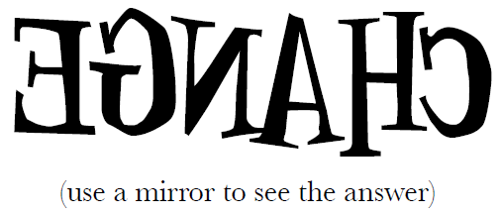
1. A Case Analysis
Inheritance: Since the duck behavior keeps changing across the subclasses, and it’s not appropriate for all subclasses to have those behaviors.
Interface: Java interfaces have no implementation code, so no code reuse.
Dalian Neusoft University of Information © Copyright

Slide 16
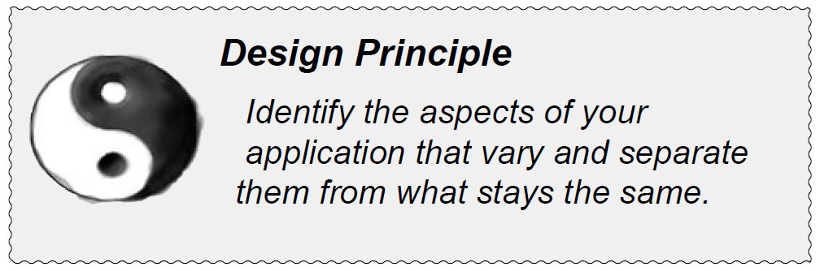
1. A Case Analysis
Dalian Neusoft University of Information © Copyright

Slide 17
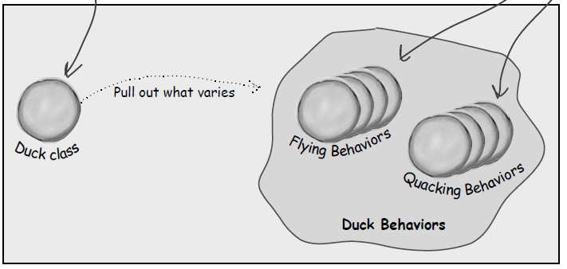
1. A Case Analysis
We know that fly() and quack() are the parts of the Duck class that vary across ducks.
Dalian Neusoft University of Information © Copyright

Slide 18
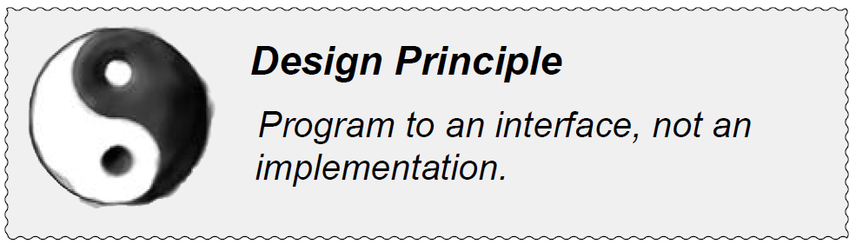
1. A Case Analysis
“Program to an interface” really means
“Program to a supertype.”
Dalian Neusoft University of Information © Copyright

Slide 19
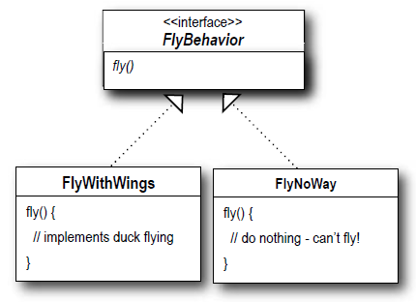
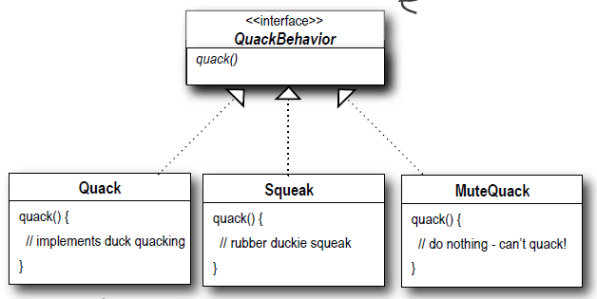
1. A Case Analysis
Implementing the Duck Behaviors
Dalian Neusoft University of Information © Copyright

Slide 20
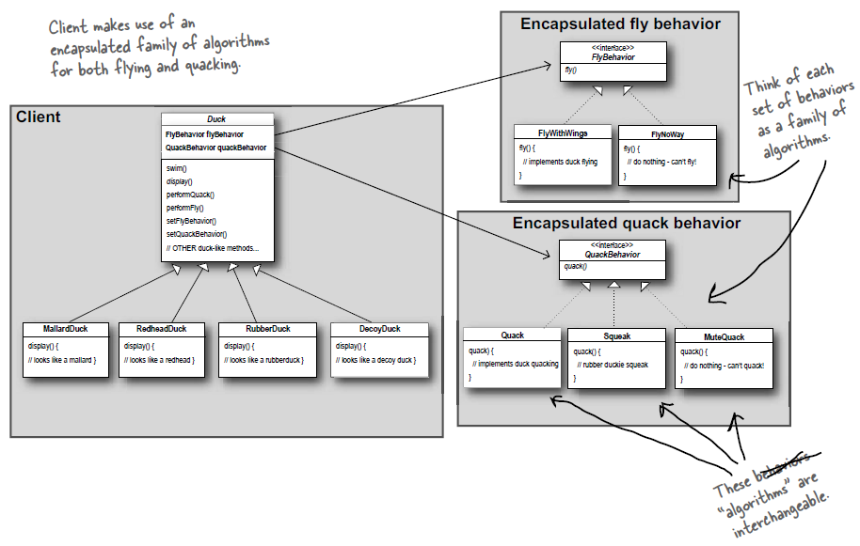
1. A Case Analysis

Slide 21
1. A Case Analysis
Composition
HAS-A
Inheritance:
IS-A
Dalian Neusoft University of Information © Copyright

Slide 22
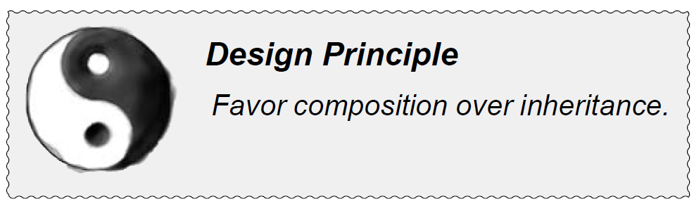
1. A Case Analysis
Notes:
优先使用（对象）组合，而非（类）继承

Slide 23
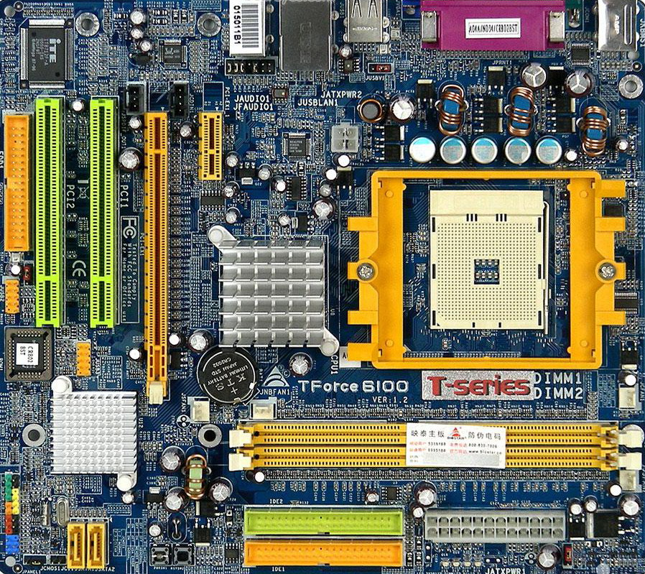
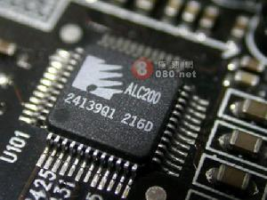
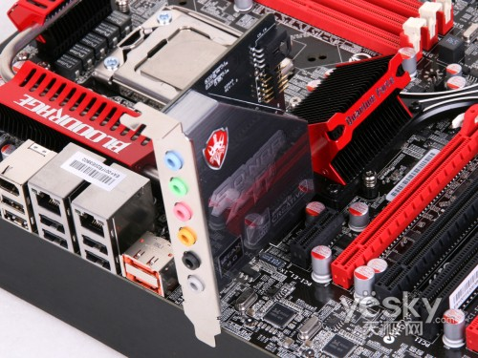
1. A Case Analysis
Integration
fixed
Independence
flexible

Slide 24
1. A Case Analysis
Interface specs of display card
board
Interface specs of sound card
display card1
sound card1
display card2
sound card2
display card3
sound card3
display card3
display card2
boardA
boardB
sound card2
sound card3

Slide 25
1. A Case Analysis
board
<<Interface>>
Duck
<<Interface>>
display card interface specs
sound card interface specs
FlyBehavoir
fly : FlyBehavoir
QuackBehavoir
quack : QuackBehavoir
fly()
quack()
swim()
display()
FlyWithWings
Quack
FlyNoWay
quack()
Squeak
sound card1
display card1
fly()
Mute
fly()
quack()
quack()
display card3
display card2
boardA
boardB
sound card2
sound card3
Readhead
Mallard
Rubber
Wooden
fly = :FlyWithWings
fly = :FlyWithWings
fly = :FlyNoWay
fly = :FlyNoWay
quack = :Quack
quack = :Quack
quack = :Squeak
quack = :Mute
display()
display()
display()
display()

Slide 26
Agenda
A Case Analysis
Design Pattern: The Strategy Pattern
An Application for example
An experiment in class
Practices of design pattern as homework
Dalian Neusoft University of Information © Copyright

Slide 27
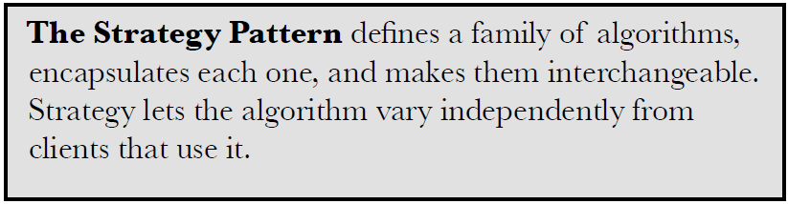
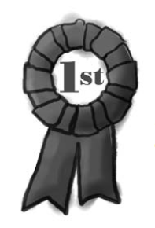
2. Design Pattern
Dalian Neusoft University of Information © Copyright

Slide 28
2. Design Pattern
Dalian Neusoft University of Information © Copyright

Slide 29
Agenda
A Case Analysis
Design Pattern: The Strategy Pattern
An Application for example
An experiment in class
Practices of design pattern as homework
Dalian Neusoft University of Information © Copyright

Slide 30
3. An Application for example
A ticketing system with different discount
Student: 80%,
Children(under the age of 10): 50%,
VIP: 70%+Gift,
In future, it is possible to have new discount.
Your job is to…
Design the class diagram
program according to your class diagram
Test your design with the price $60.
Dalian Neusoft University of Information © Copyright

Slide 31
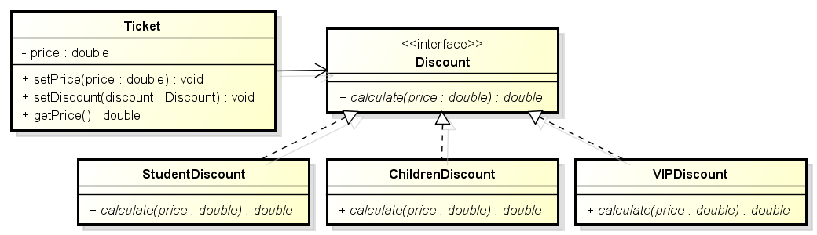
3. An Application for example
A ticketing system with different discount
Class Diagram

Slide 32
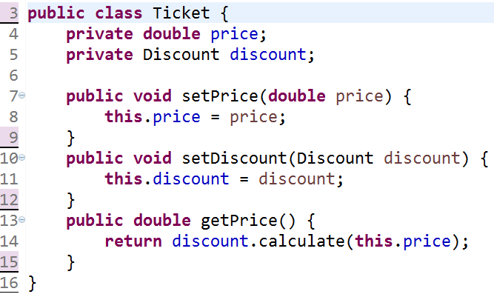
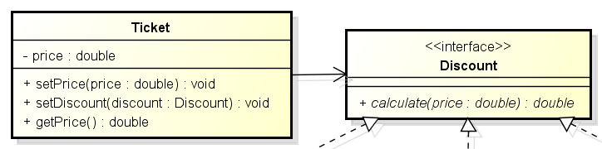
3. An Application for example

Slide 33
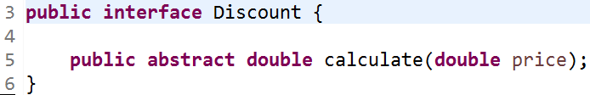
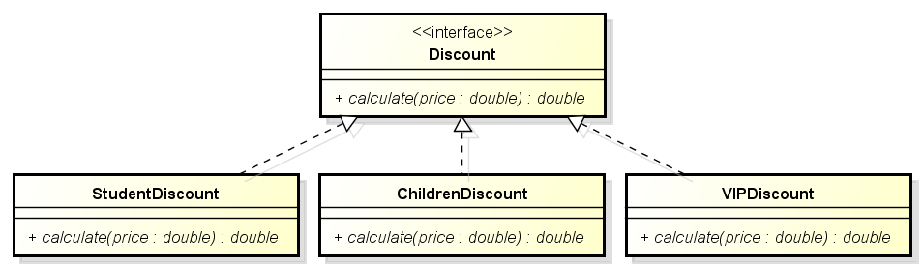
3. An Application for example

Slide 34
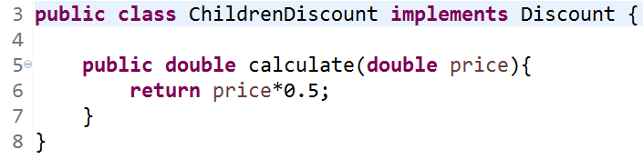
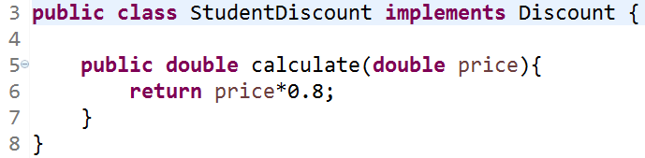
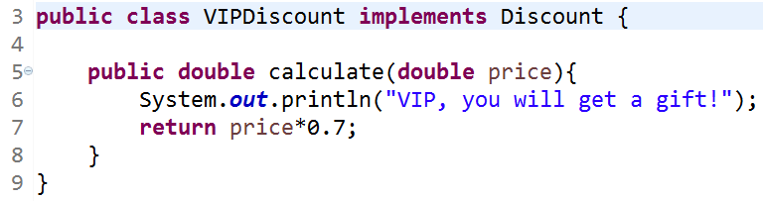
3. An Application for example

Slide 35
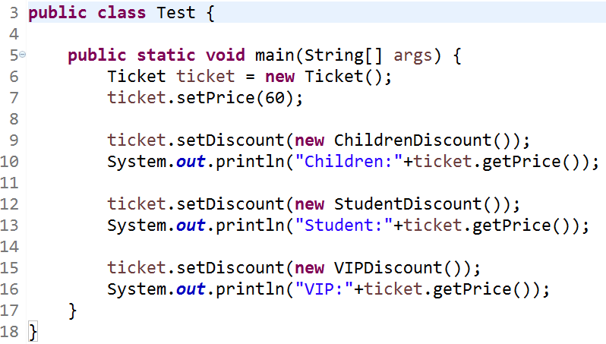
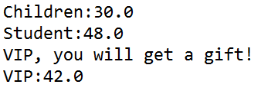
3. An Application for example
Console output:

Slide 36
Agenda
A Case Analysis
Design Pattern: The Strategy Pattern
An Application for example
An experiment in class
Practices of design pattern as homework
Dalian Neusoft University of Information © Copyright

Slide 37
4. An experiment in class
A flight simulation system to simulate the flight characteristics and takeoff characteristics
Aircraft type | flight characteristics | takeoff characteristics
Helicopter | VerticalTakeOff | SubSonicFly
AirPlane | LongDistanceTakeOff | SubSonicFly
Fighter | LongDistanceTakeOff | SuperSonicFly
Harrier | VerticalTakeOff | SuperSonicFly
Your job is to…
Design the class diagram
program according to your class diagram
Test your design.
Dalian Neusoft University of Information © Copyright

Slide 38
Agenda
A Case Analysis
Design Pattern: The Strategy Pattern
An Application for example
An experiment in class
Practices of design pattern as homework
Dalian Neusoft University of Information © Copyright

Slide 39
5. Homework
Finish the homework, which includes 3 tasks.
Dalian Neusoft University of Information © Copyright

